Slide 1
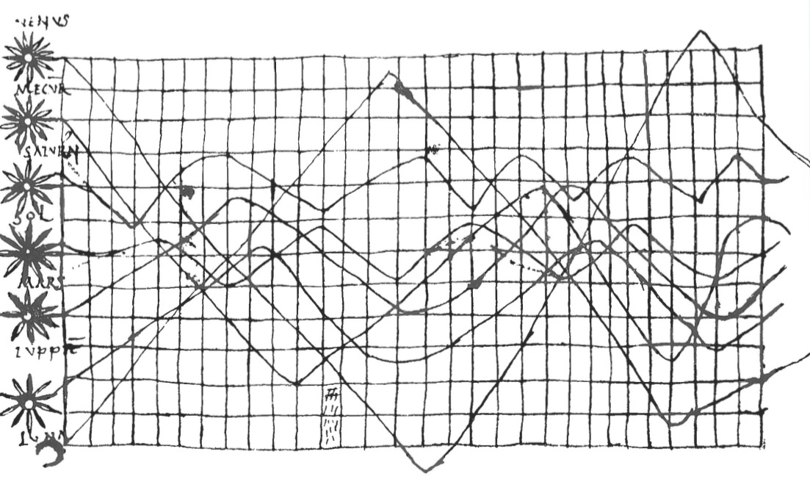
Data Visualization

Slide 2
Data visualization is Communication

Slide 3
Principles of Graphical Excellence
Clarity
Precision
Efficiency
Maximize ideas, minimize ink
(from Tufte)

Slide 4
Data Viz in a Nutshell
History
Graphical Basics
Minimalist principles

Slide 5
Data Viz in the 10th Century
From Funkhouser 1936
Notes:
10th century
What do you see here. What works. What does not?

Slide 6
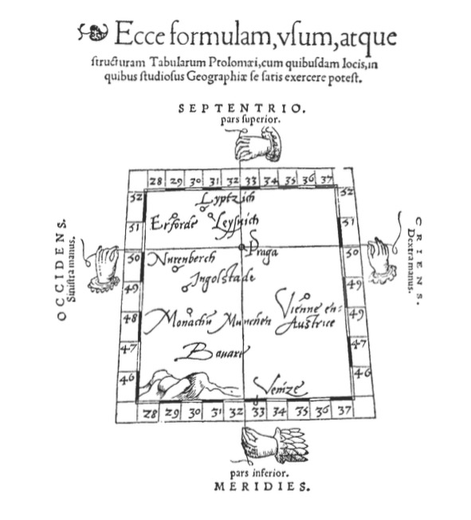
Notes:
Early maps. Little information beyond intersections – 1546 from Pedrus Apenius
What do you get from this?

Slide 7
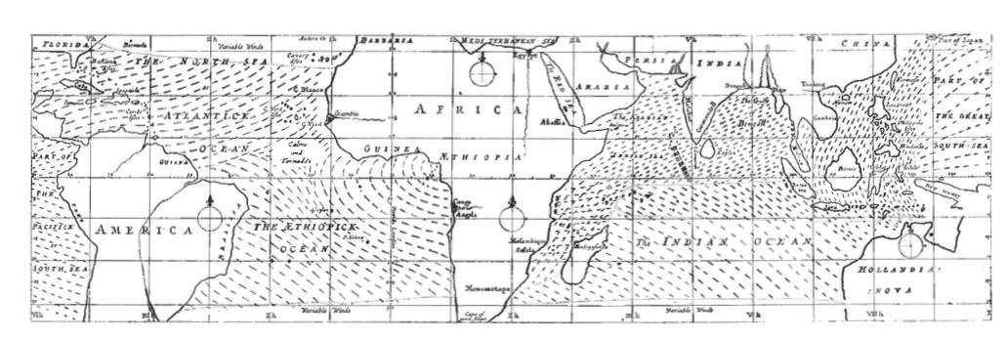
Maps as Rich Information Source
Notes:
Edmond Halley 1686

Slide 8
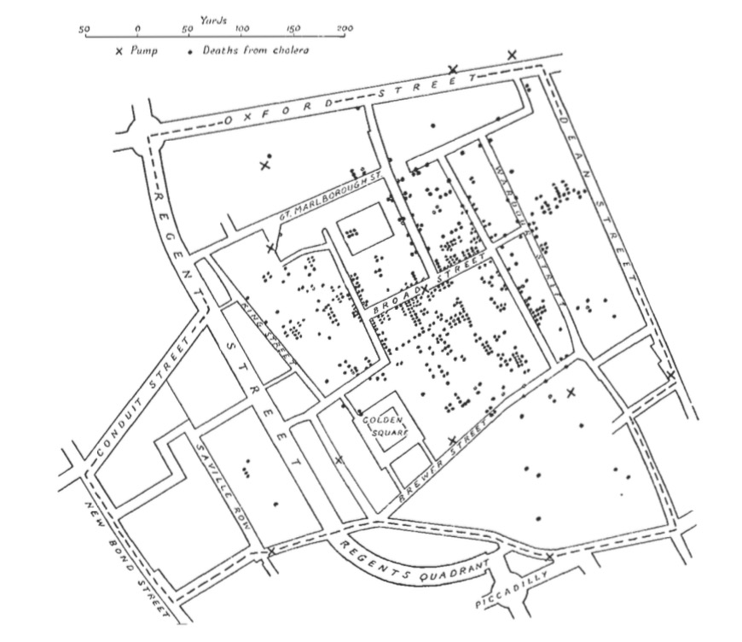
Spatial Patterns Intuitive
Notes:
How would you make this abstract?
John Snow 1854
It’s not all maps – timeseries, particularly as govs started getting into data

Slide 9
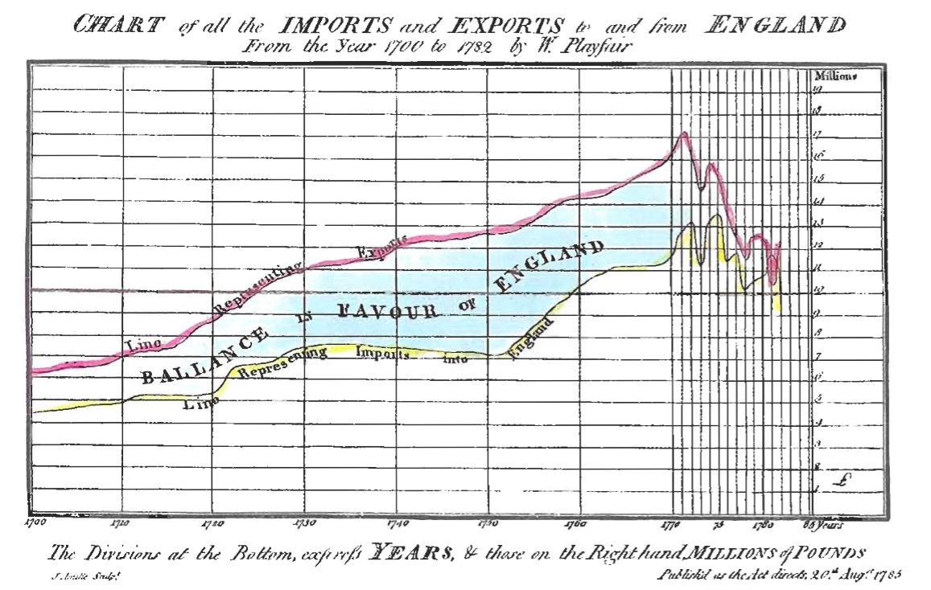
Notes:
Playfair! A father of modern statistical graphics

Slide 10
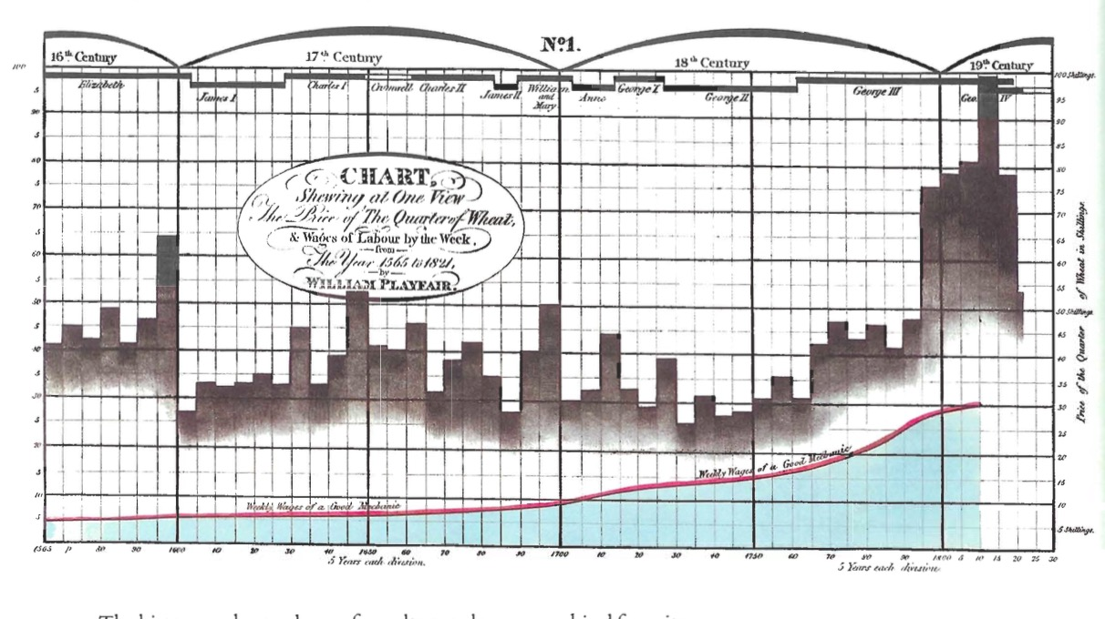
Multiple Data Sources to Make a Point

Slide 11
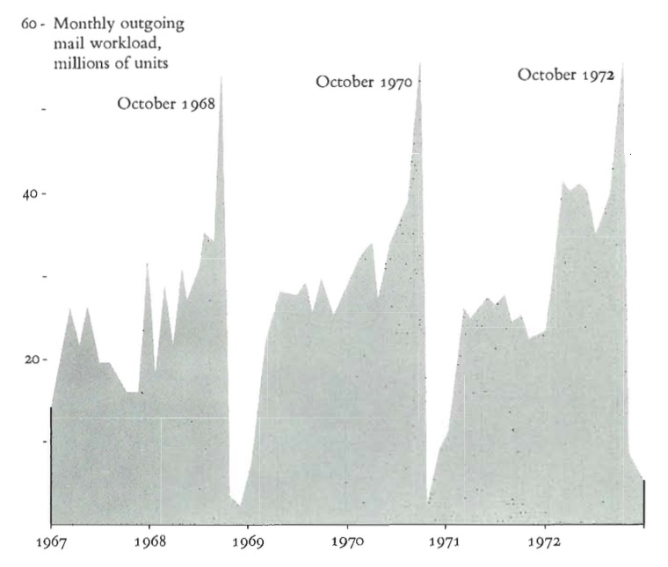
Sometimes One Variable is Enough

Slide 12
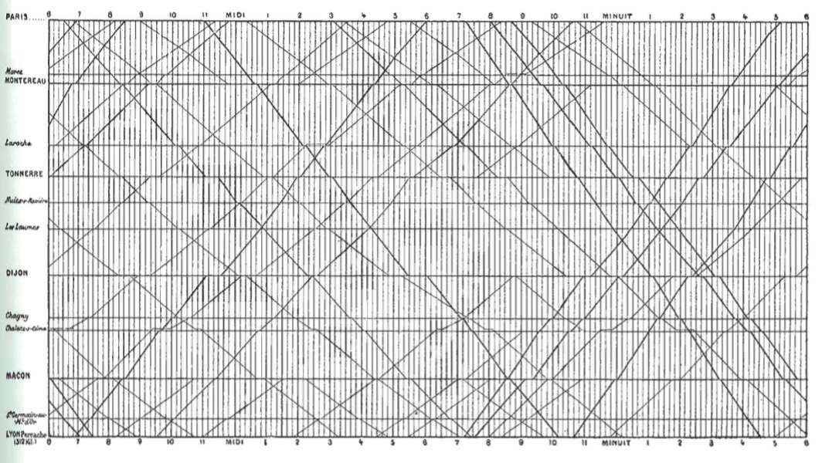
Adding Space to Time
Notes:
Marey’s train graph
What works, what doesn’t?

Slide 13
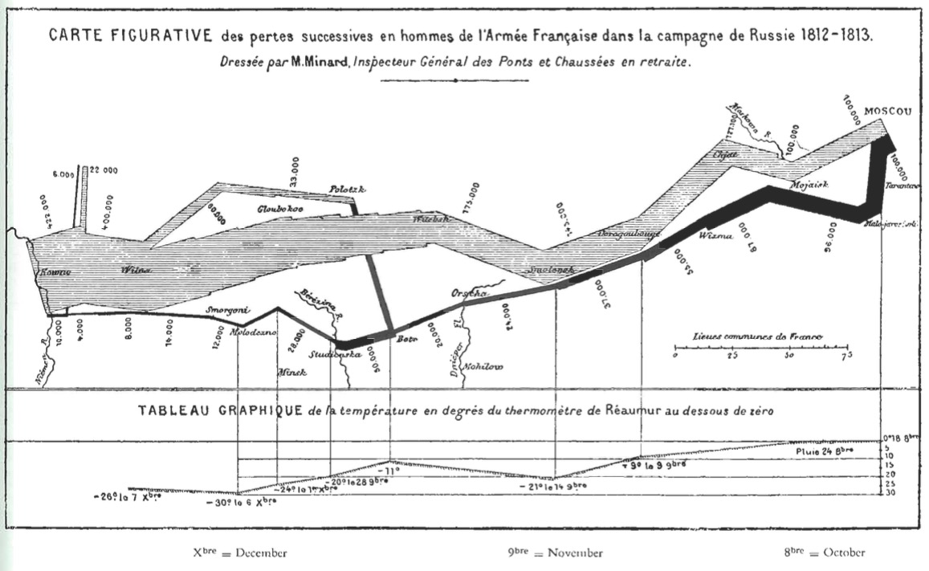
Unifying Maps and Timeseries

Slide 14
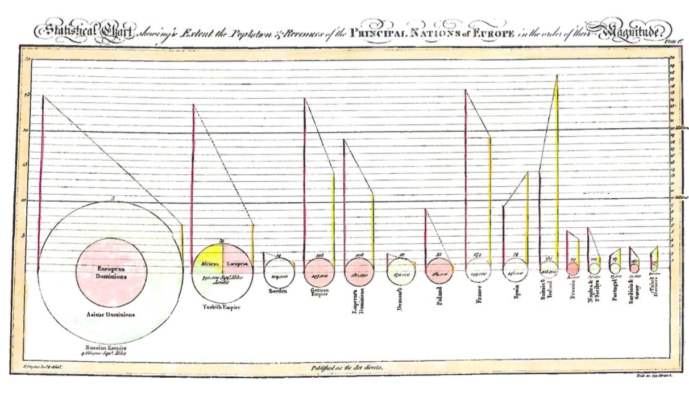
Abstracting Variables to Make a Point
Notes:
Playfair again!

Slide 15
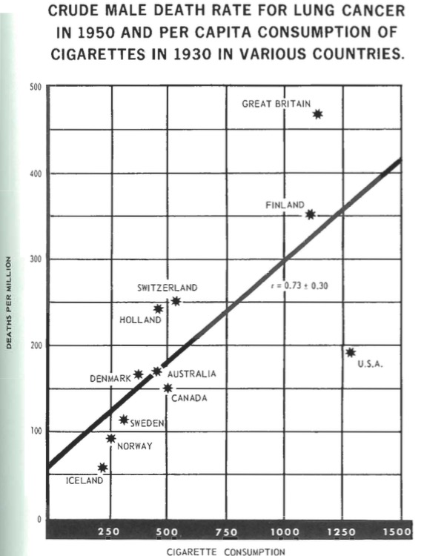
Notes:
Abstract & Statistical Information
1955 Surgeon General’s Report

Slide 16
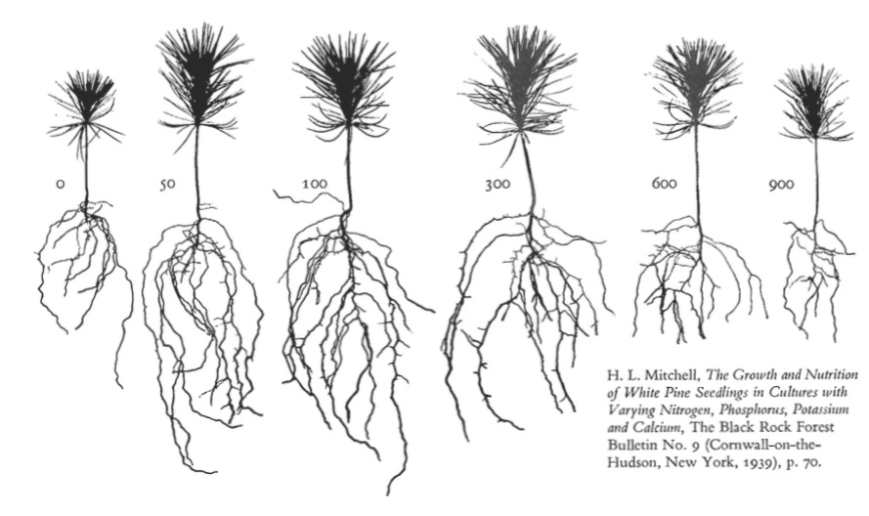
Abstraction Can Tell Wonderful Stories

Slide 17
Data Viz in a Nutshell
History
Graphical Basics
Minimalist principles

Slide 18
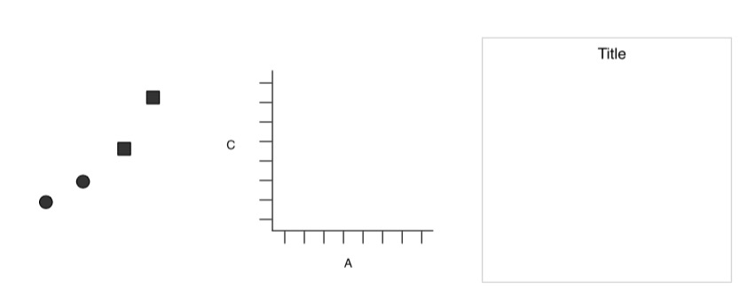
Elements of a Plot
Geometric Objects
Scales & Coordinates
Annotations
Wickham 2010

Slide 19
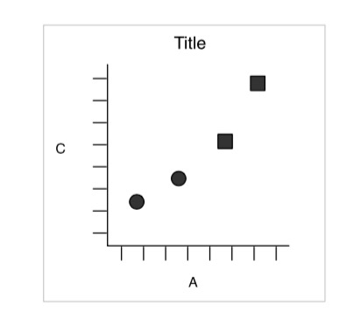
Elements of a Plot
Wickham 2010

Slide 20
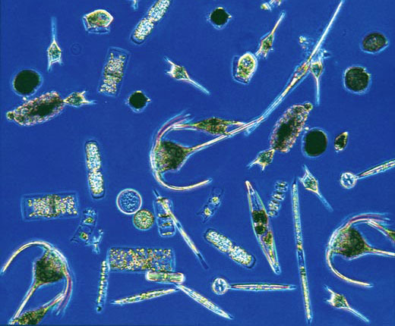
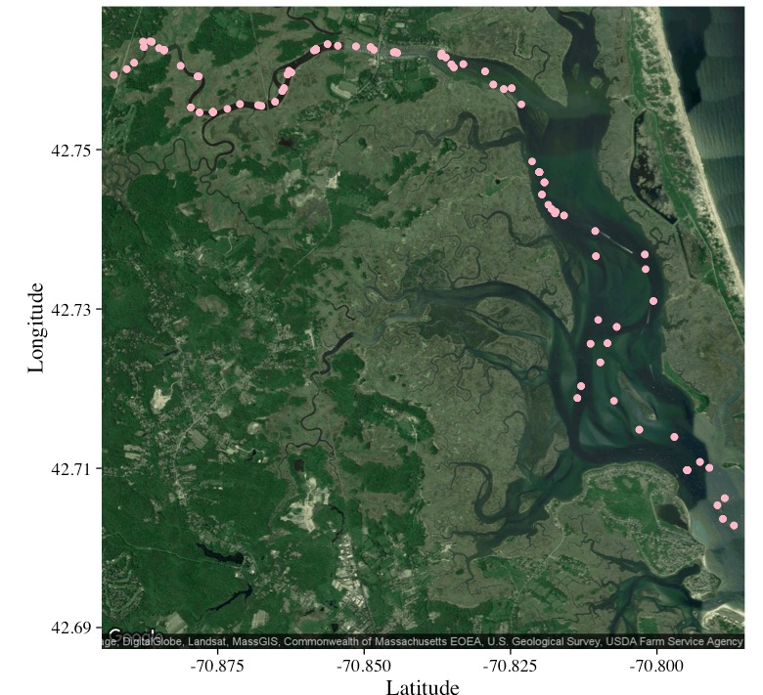
Plankton Data from Plum Island
Chlorophyll a
Abundance of taxonomic groups
Temperature
Salinity
Hopkinson and Hobbie 2012 http://ecosystems.mbl.edu/PIE/data/EST/EST-PR-ChemTax.html

Slide 21
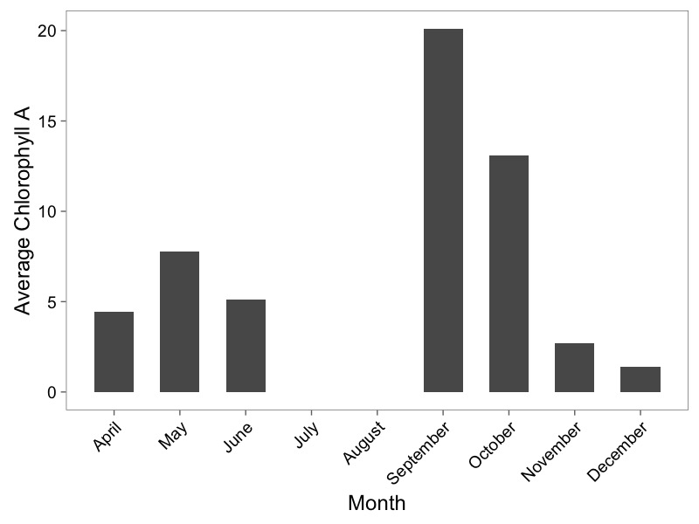
Barplots

Slide 22
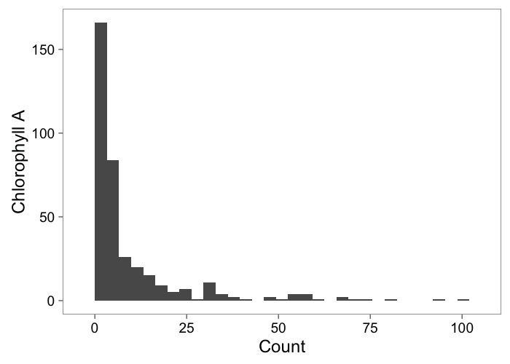
Histograms Show Frequency

Slide 23
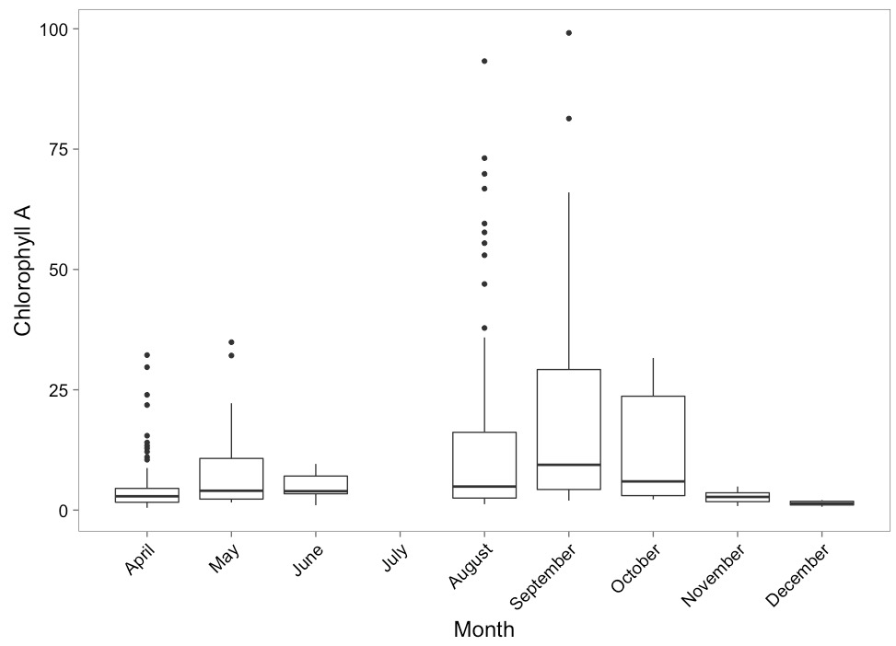
Boxplots to Show Variation

Slide 24
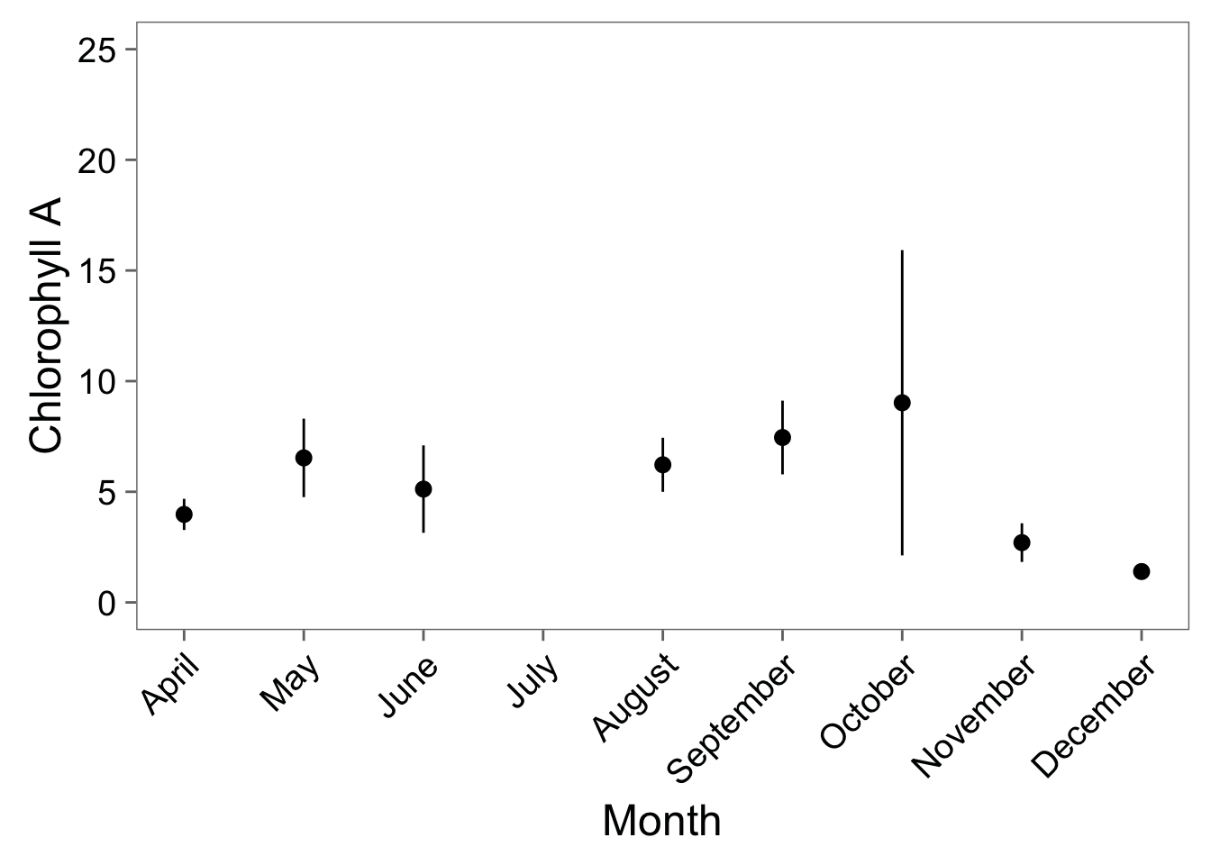
…Or Point-Ranges

Slide 25
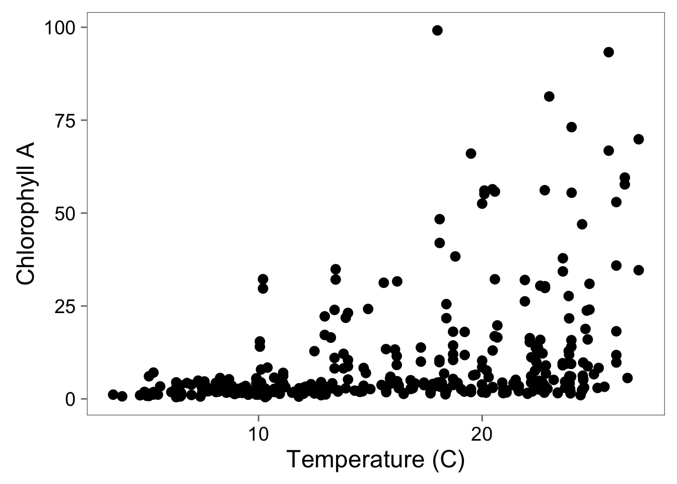
Scatterplots Show Relationships

Slide 26
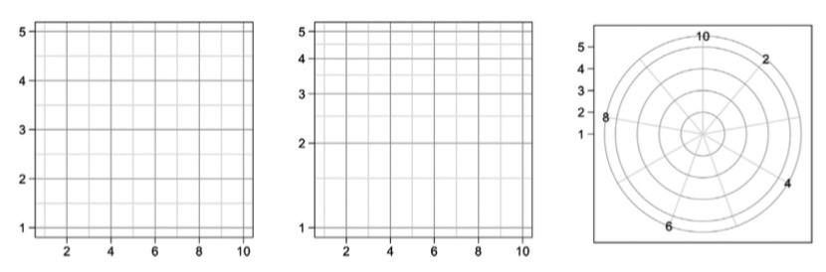
Coordinate Systems Transform Relationships

Slide 27
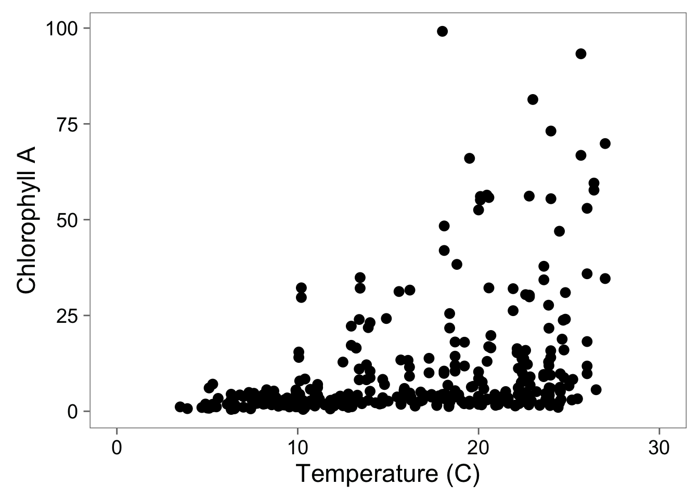
Adding Full Scale to 0

Slide 28
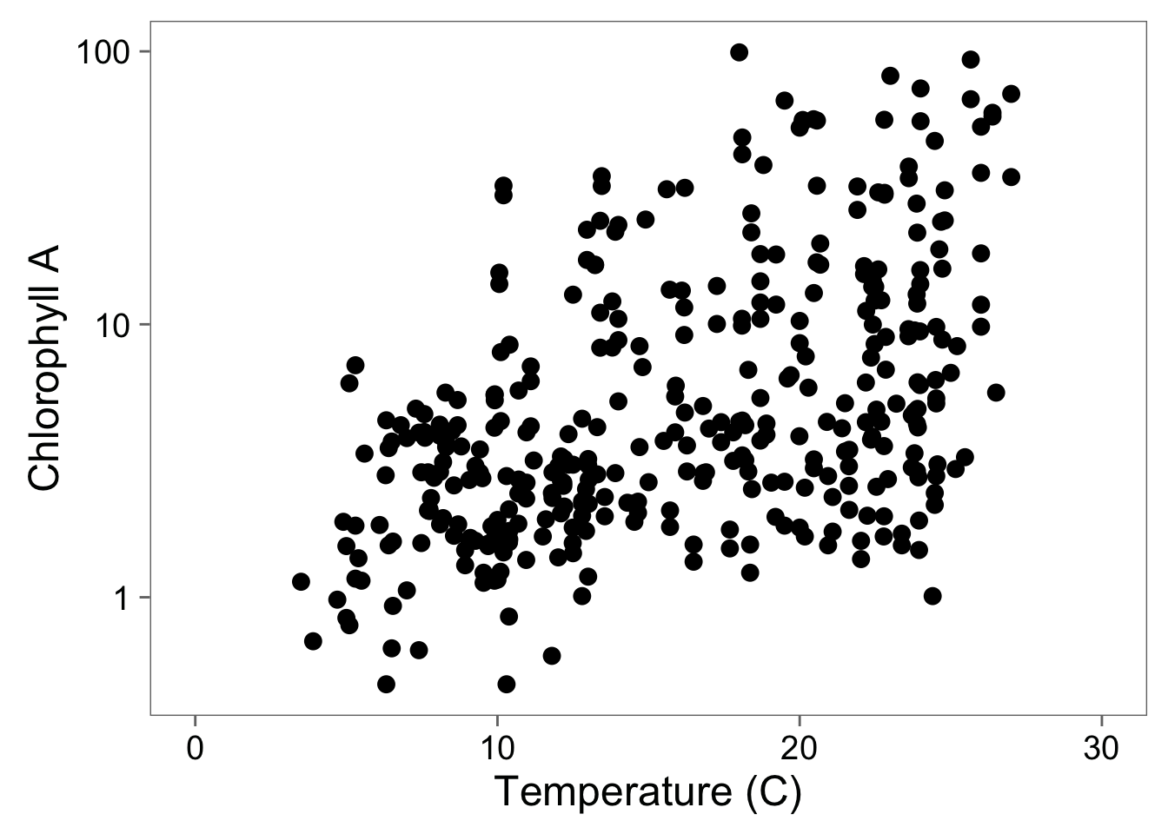
Log-Transformation To See Relationship

Slide 29
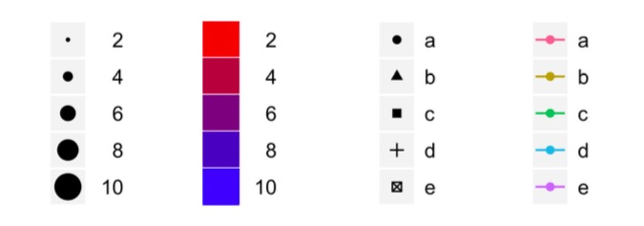
Scales to Add Dimensions of Data

Slide 30
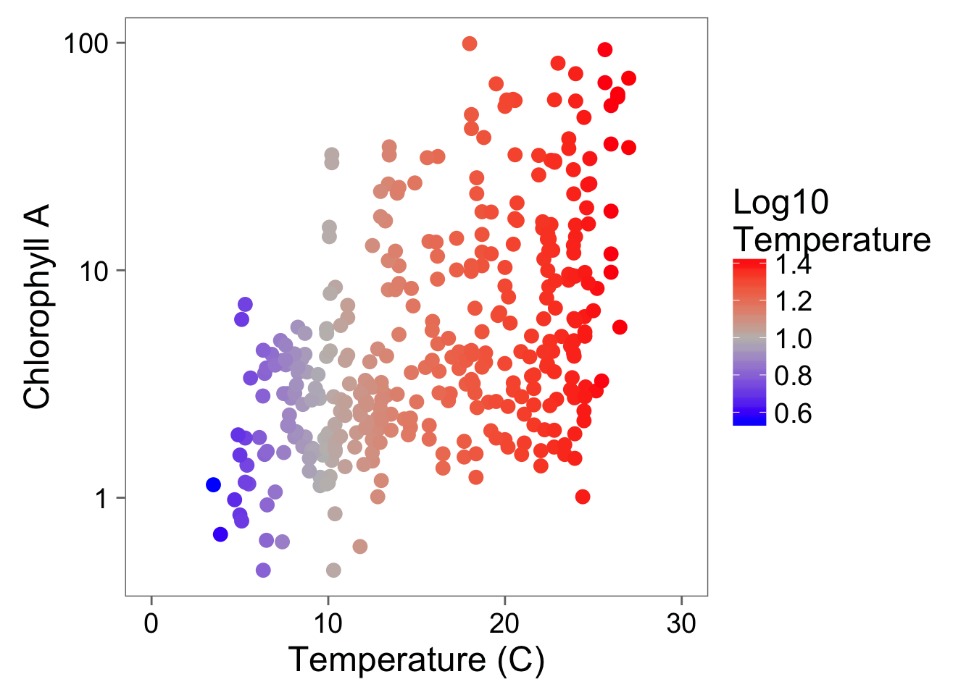
A Touch of Color!

Slide 31
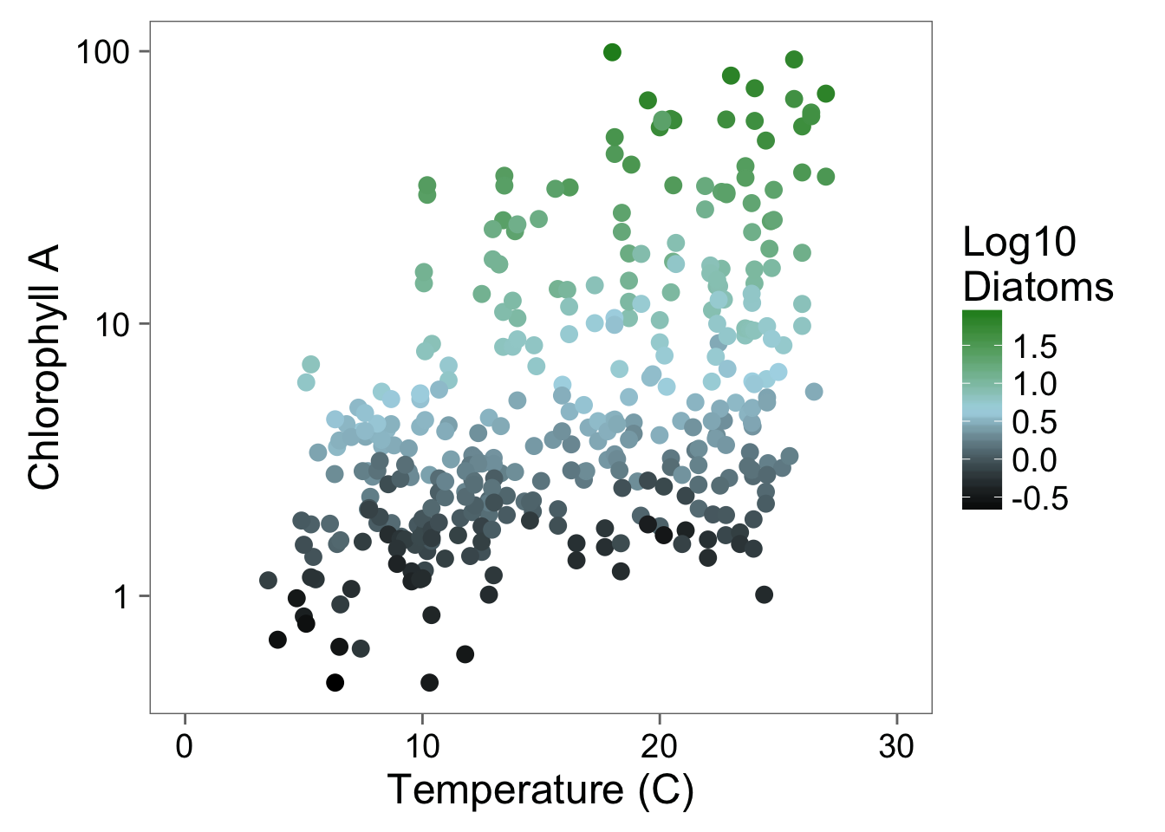
Color Can Bring in Another Dimension

Slide 32
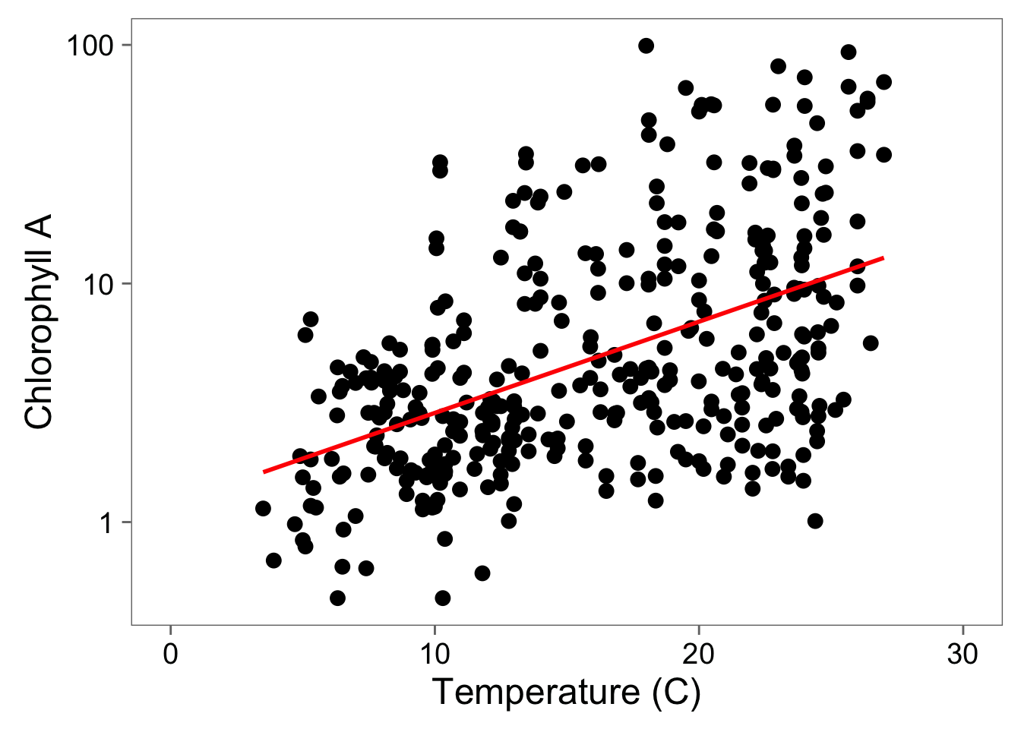
Statistical Fit to Aid Understanding

Slide 33
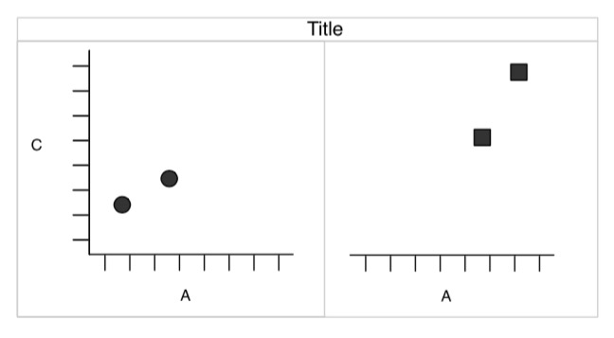
Facets to Add Fine-Grained Information or New Dimensions

Slide 34
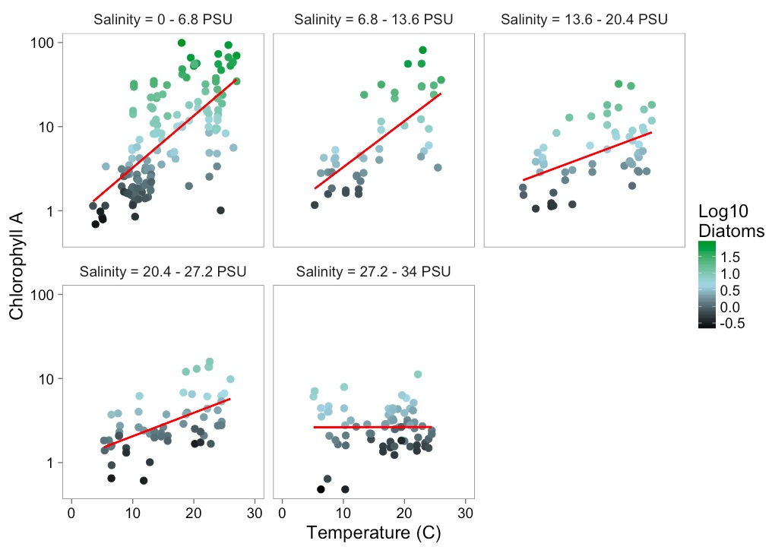
Facets Add Information

Slide 35
Data Viz in a Nutshell
History
Graphical Basics
Minimalist principles

Slide 36
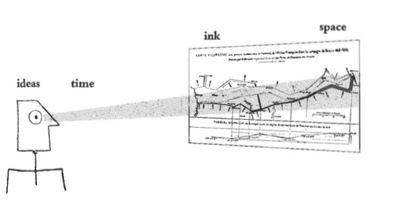
Minimalist Presentation
Above all else show data.
2. Maximize the data-ink ratio
3. Erase non-data-ink.
4. Erase redundant data-ink.
Tufte 2002

Slide 37
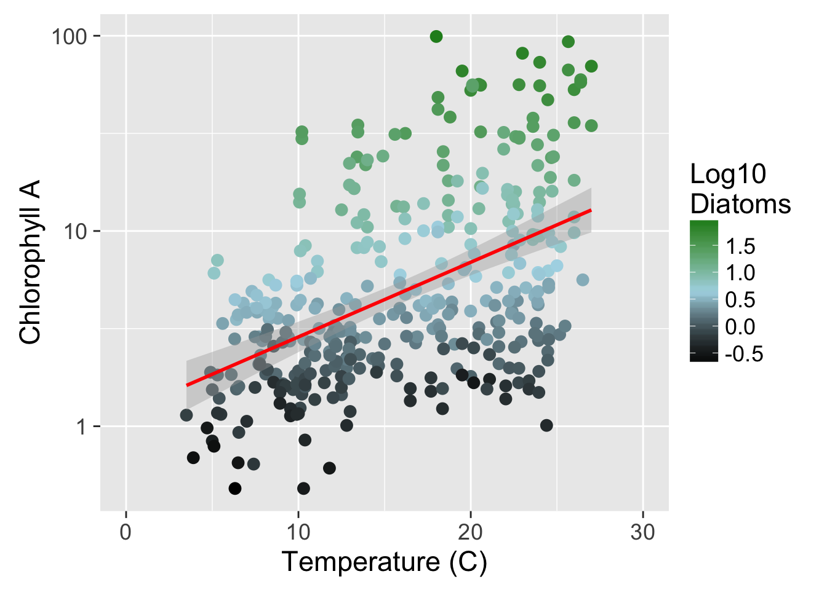
Show the Data

Slide 38
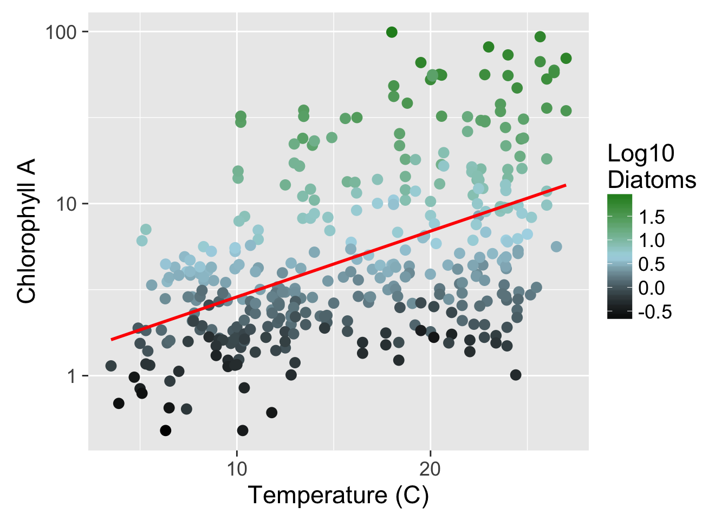

Slide 39
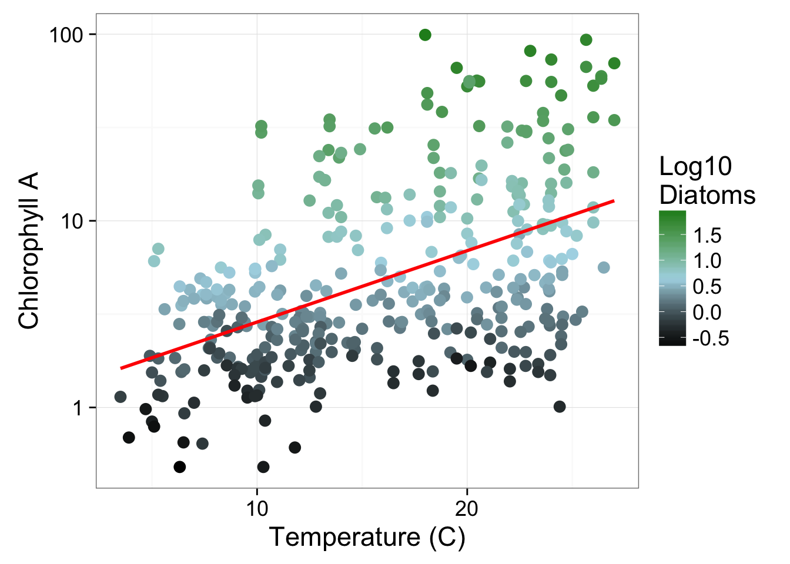

Slide 40


Slide 41
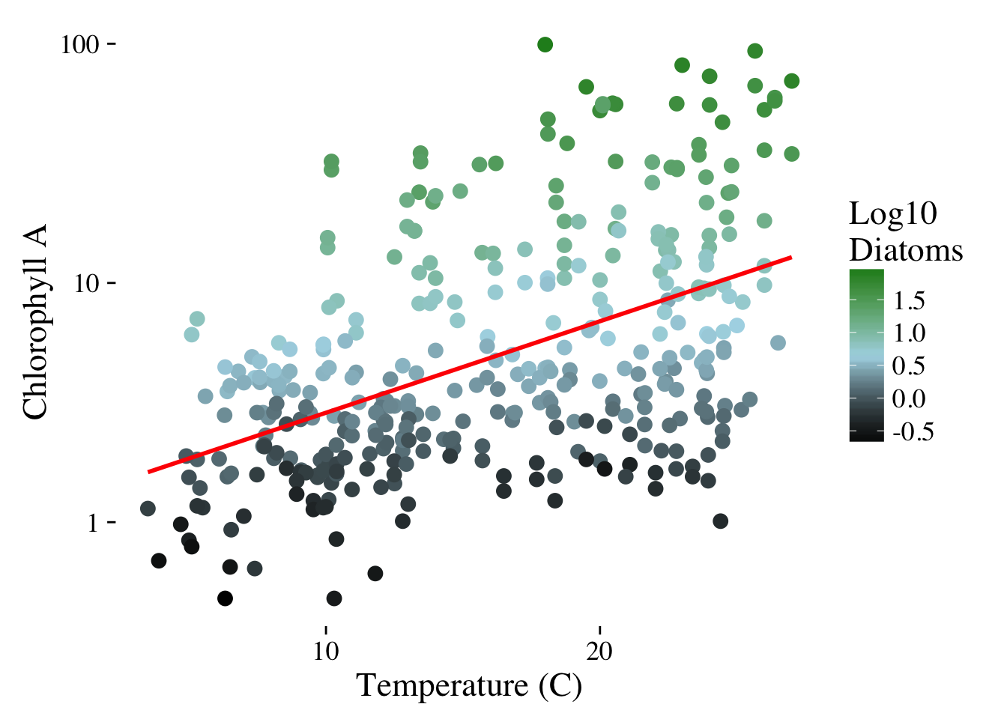

Slide 42
